Slide 1
VIP 2.0
Team Members:
Tiago Moore, Victoriano Vega, Steven Rowe,
Jorge Perez, Andres Villa, Miguel Conde, Rodolfo Viant Product Owner:
Masoud Sadjadi Instructor:
Masoud Sadjadi
School of Computing and Information Sciences Florida International University
Senior Project Final Presentation Spring 2016
4/25/2016

Slide 2
Problem Definition
Our Project
Mobile Judge is a web application that is built more for mobile devices to be the primary use. Mobile Judge is the application that judges will be using to score students during the senior project showcase.
Current Problems
My Part
Lacked the ability to accept/reject grades
View/update user profile page
Ability for admin to filter email selections
Social media account linking
Pagination on all grids
Export grades/judges
Import Students
Manage Student/Judges information
Allow the Admin to
Accept Grades and Reject Grades per students and per Judges.
Change the grade and the comment per students and per Judges.

Slide 3
System Design: Architecture
3-tier and Client-Server architecture
Security/Privacy
Oauthd authentication
Hashing and salting of passwords
Sanitizing user input
Token based authentication (bcrypt)
Notes:
5. System design:
5.1. System decomposition; identify the architecture patterns used (one slide).
5.2. System deployment – h/w and s/w requirements (one slide).
5.3. Persistent data design (one slide).
5.4. Security/Privacy (one slide).

Slide 4
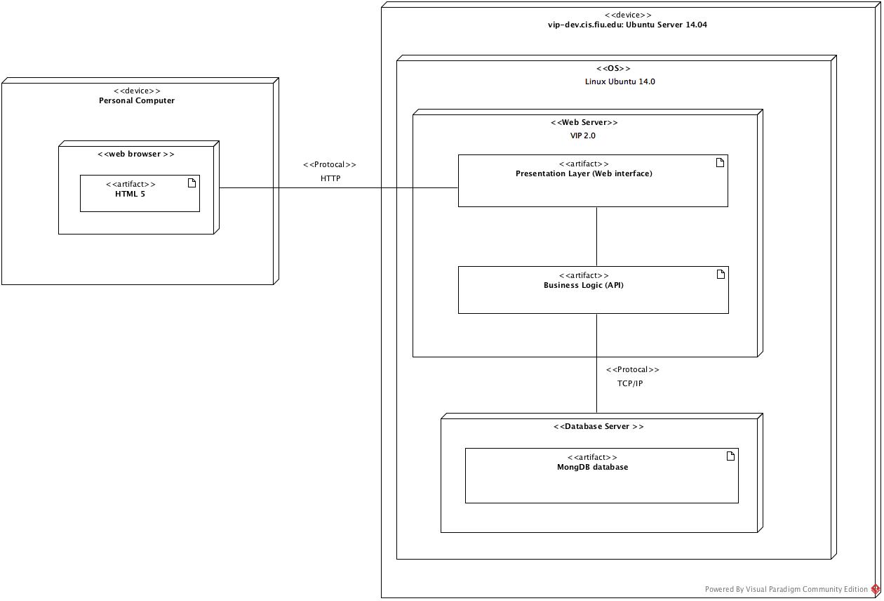
System Design: Deployment

Slide 5
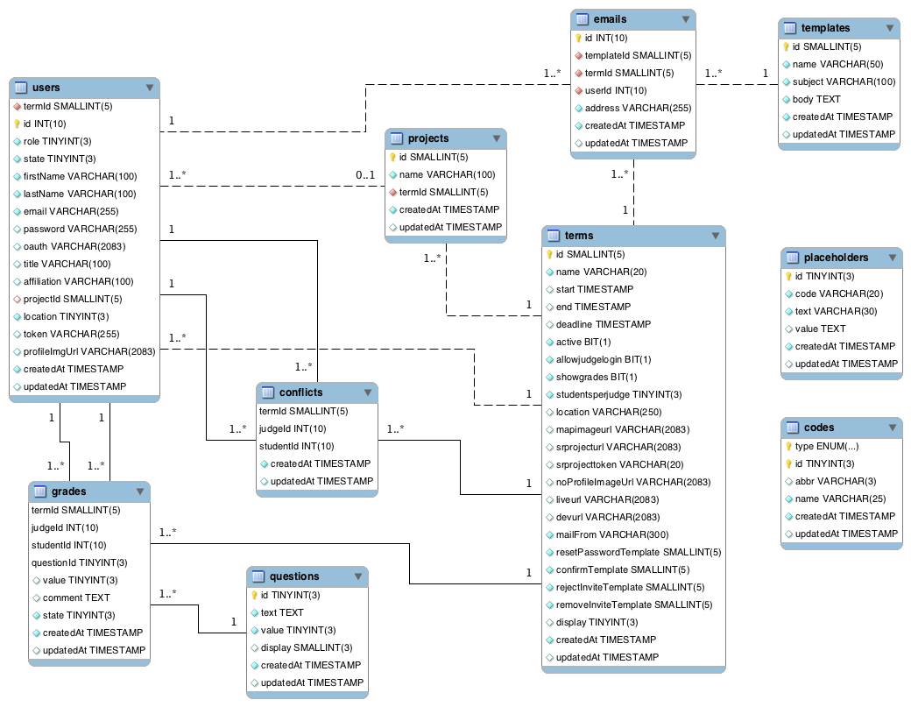
System Design: Persistent data design

Slide 6
Minimal Class Diagram
Notes:
6. Detailed design:
6.1. Minimal class diagram. Identify the design patterns used (one or more slides).
6.2. State machine for the main control object or the most important object of the implemented uses cases (one or more slides).
6.3. Main algorithm used related to an implemented use case described above (one or more slides).

Slide 7
Requirements: User Stories
#525-Review Grades. Accept Reject Grades.
Create new Data Views to feed the Models.
Implement Visual representation of Grades States.
Implement the Main View, Detail View and Judge Detail View.

Slide 8
Requirements: Use Cases
#525-Review Grades
Use Case ID: MJ520 - Review Grades
Details:
Actor: Admin
Pre-conditions:
Admin has successfully logged onto the system.
Judges must have graded the students.
Description:
Use case begins when the admin clicks the Grades tab on the nav bar.
The system shall show the Student tab with a grid containing student information.
The actor shall click the traffic light icon at the top to change the status of the students grades.
The system shall modify the grades for the students currently being displayed and set them to the next state.
The system shall then refresh the information and the image of the Icon reflecting the value of the set of students in that page.
Post-conditions:
Alternate:
The user clicks the traffic light icon in one row to change the status of the grade for that one student .
The system should complete step 4 and 5 for the one student.

Slide 9
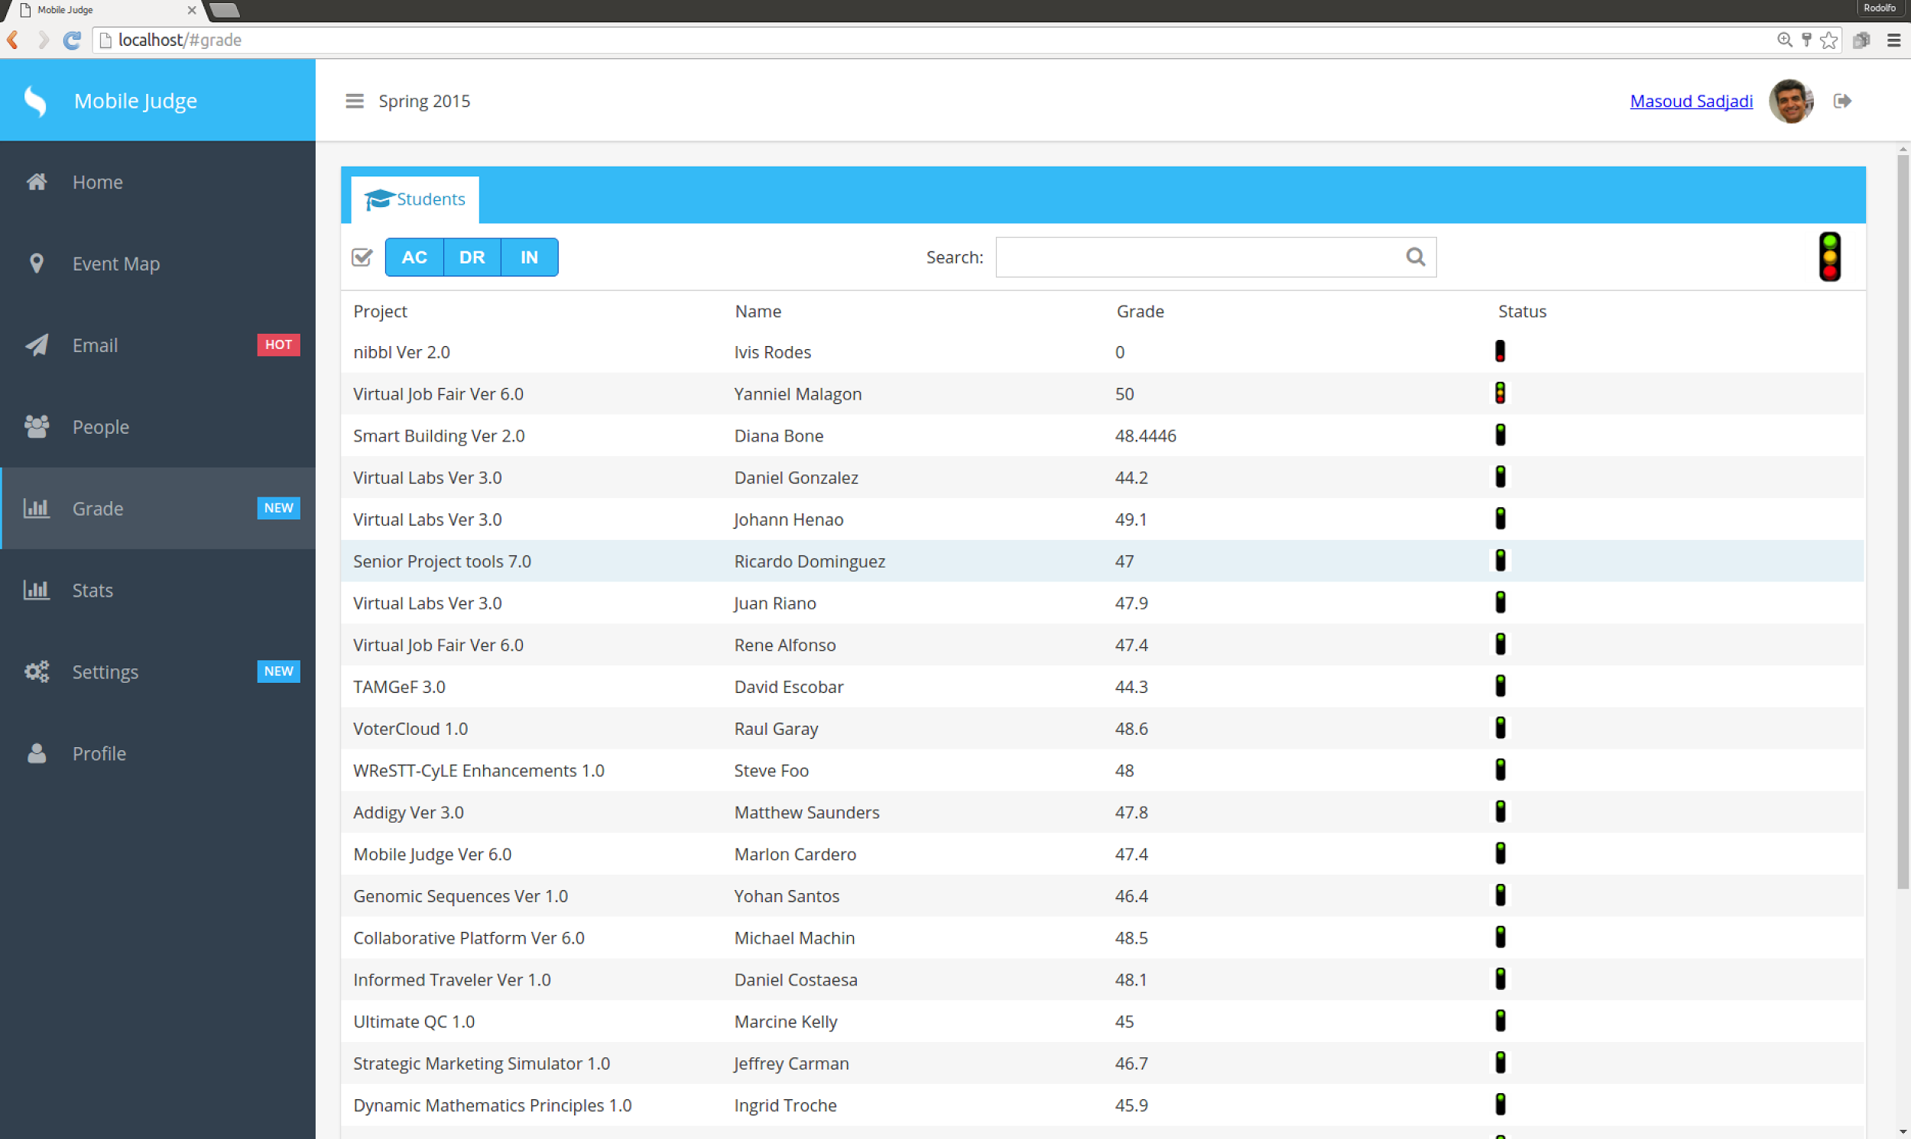

Slide 10
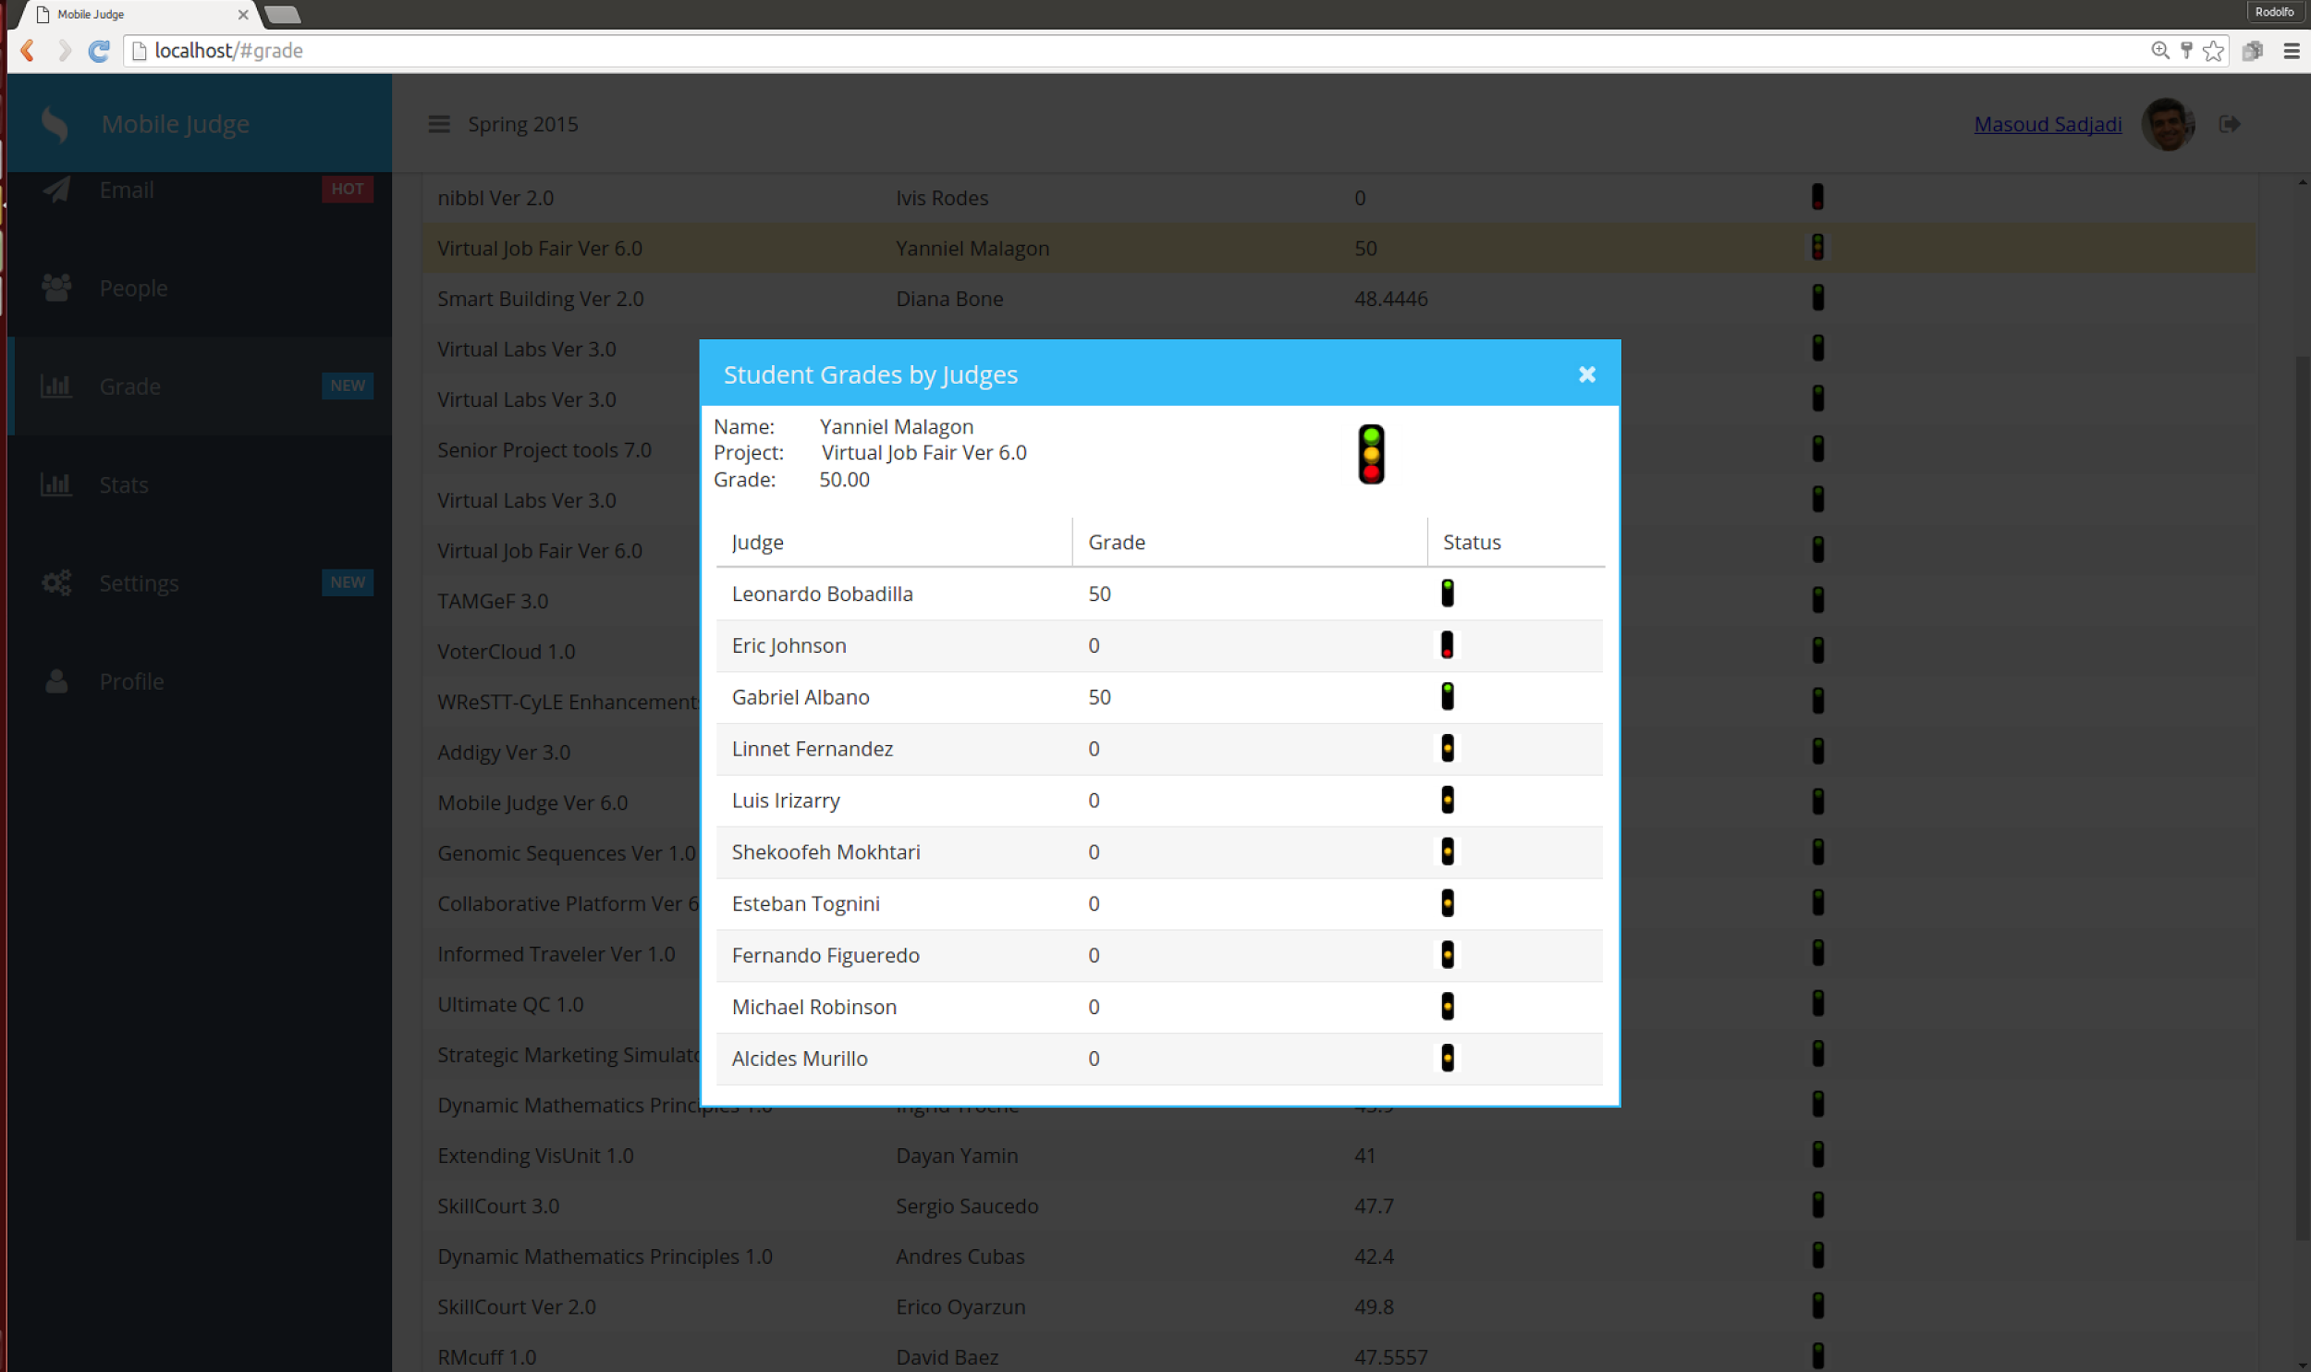

Slide 11
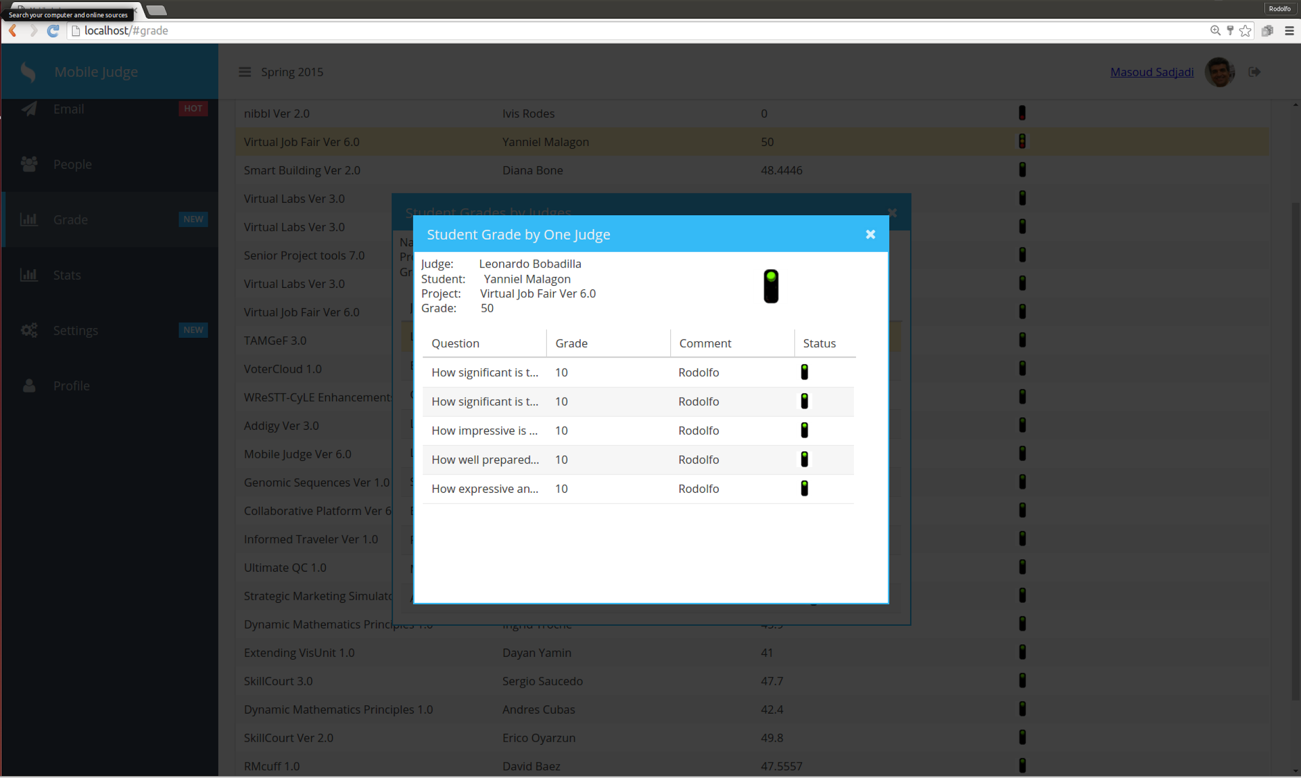

Slide 12
Requirements: Sequence Diagrams
#525-Review Grades

Slide 13
Requirements: Sequence Diagrams
#525 Review Grades

Slide 14
Requirements: Use Cases
#525- Review Grades, A

Slide 15
Test Cases - #525 Review Grades
ID: MJ-SD-525
Sunny Day
Purpose
Test if change grade status for a student.
Precondition
Admin has successfully logged onto the system.
Judges have graded the students.
Input
Admin clicks on green traffic light icon .
Expected Result
Traffic Light changes color.
Actual Result
Traffic Light changed color.

Slide 16
Test Cases - #525 Review Grades
ID: MJ-RD-525
Rainy Day
Purpose
Test if you can change grade status for a student from a past Term.
Precondition
Admin has successfully logged onto the system.
Judges have not graded the students.
Input
Admin clicks on Grades Tab.
Expected Result
No Student should appear for grading
Actual Result
No Student should appear for grading.

Slide 17
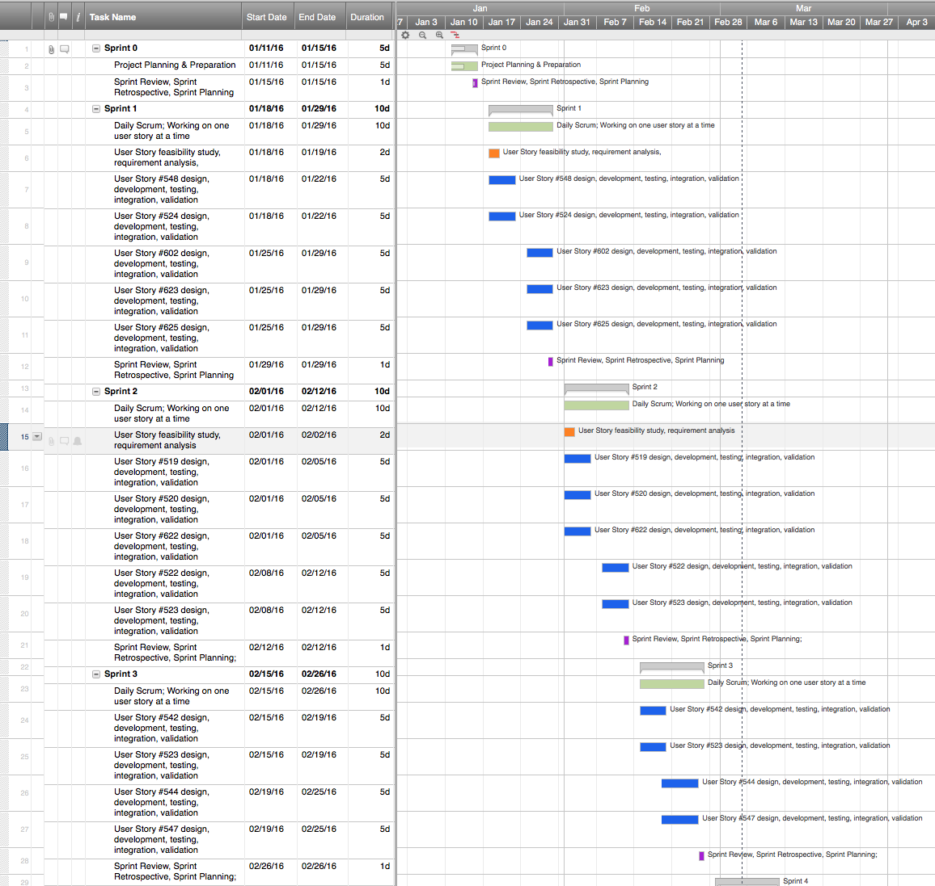
Project Management

Slide 18
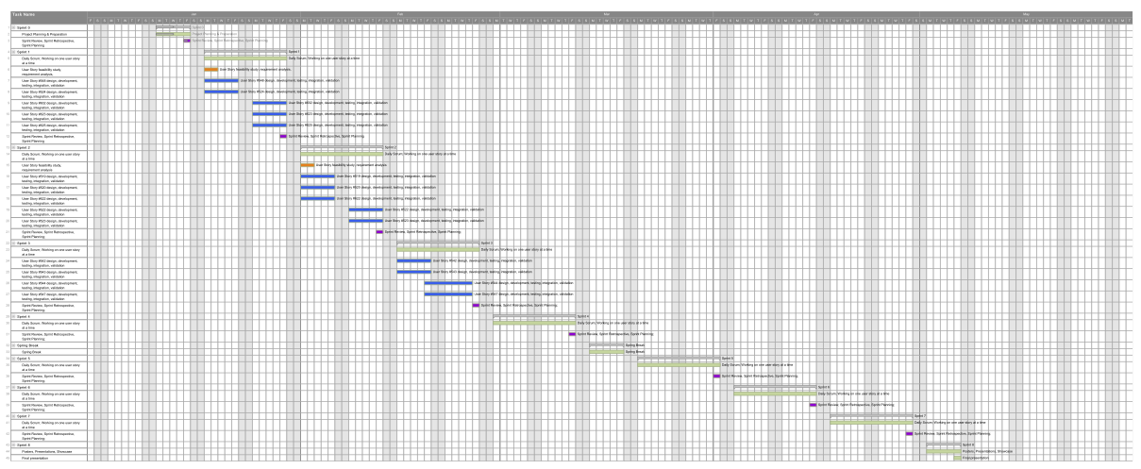
Full Gantt chart

Slide 19
Thank you!
Contact information:
Rodolfo Viant email: rvian003@fiu.edu

